Slide 1

America’s Power Journey 2000 – 2020

Slide 2
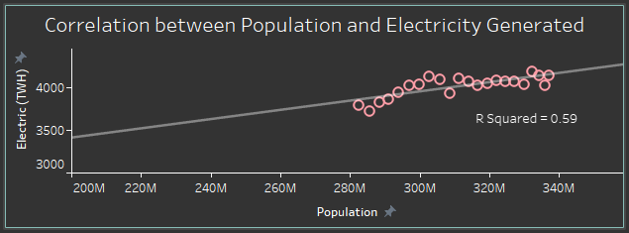
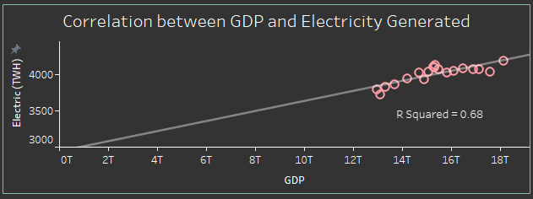
Electricity
As the population increased and the world became industrialized, energy needs increased.
We turned to new ways of generating power:
Late 19th century, the first power plant built used coal to generate electricity.
Early 20th century, hydroelectric power emerged
Mid 20th century, nuclear power emerged

Slide 3
Fossil Fuels
Gas-fired Power Plants
Natural gas is abundant and relatively cheap, making it an attractive source of electricity for many utilities.
Coal-fired Power Plants
Coal is cheap and abundant but is also a major contributor to air pollution and greenhouse gas emissions.
Oil-fired Power Plants
Are less efficient than gas-fired power plants, emitting higher levels of air pollutants like sulfur dioxide, nitrogen oxides, and particulate matter.
Plays a role where natural gas is not available or where oil is abundant and relatively cheap.
Notes:
use the combustion of gas to heat water and create steam, which then drives a turbine to generate electricity
work on the same principle as natural gas-fired plants but

Slide 4
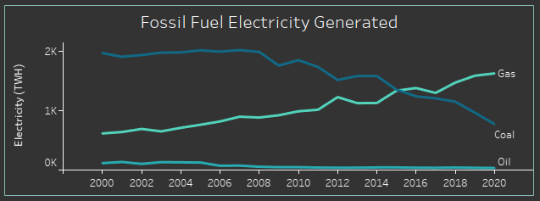
Coal electricity has been declining over the years
Natural gas electricity has been increasing and has become the dominant source of electricity.
Oil electricity has been steady with a slight decline

Slide 5
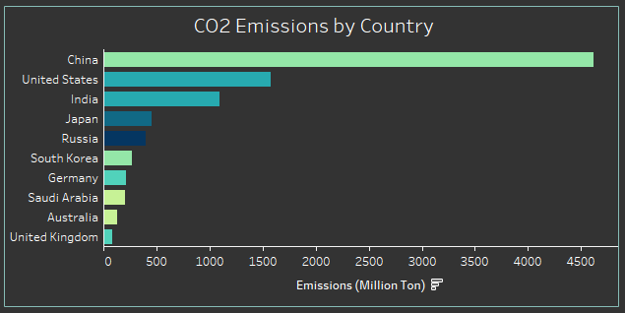
CO2 Emissions
The United States is the second largest producer of carbon emissions, and the electric power sector is the second largest producer of these emissions.
Currently, nearly 40% of all carbon dioxide pollution comes from power plants burning fossil fuels to generate the electricity we use every day.

Slide 6
Climate Crisis
CO2 emissions are the primary driver of climate change, leading to global warming, disruptions in weather patterns, rising sea levels, and environmental and social challenges.
The Biden administration plans to eliminate fossil fuels as a form of energy generation, for which it has set out the following targets:
80% renewable energy generation by 2030
100% carbon-free electricity by 2035
net-zero carbon emissions by 2050

Slide 7



Renewable
Hydro Electricity
use the energy of falling water to spin turbines, which in turn generate electricity.
Limited by the availability of water and adequate locations for dams
Solar Electricity
PV Solar Plants
use arrays of solar panels to convert sunlight directly into electricity
CSP Solar Plants
use mirrors to concentrate sunlight onto a small area, heating a fluid to create steam that drives a turbine to generate electricity
Wind Electricity
Turbines convert the kinetic energy of wind into electricity

Slide 8
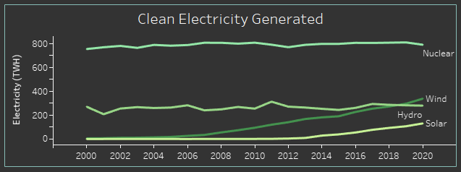
Hydro electricity accounted for about 7% of total electricity generation in 2020, which has remained relatively stable over the past 2 decades.
Wind electricity accounted for about 8% of total electricity generation in 2020, up from less than 1% in 2000.
Solar electricity accounted for about 3.5% of total electricity generation in 2020, up from less than 0.1% in 2000.

Slide 9
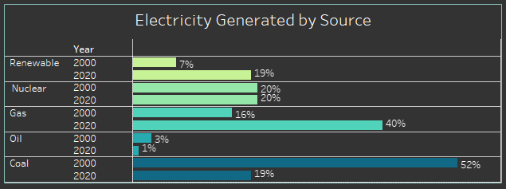
Renewable accounts for about 19% of total electricity generation in 2020, up from about 7% in 2000. 24% increase
Coal electricity accounts for about 19% of total electricity generation in the United States in 2020, down from about 52% in 2000. 33% decrease
Gas electricity accounts for about 40% of total electricity generation in 2020, up from about 16% in 2000. 24% increase
Oil electricity accounts for less than 1% of total electricity generation in 2020, down from about 3% in 2000. 2% decrease
Nuclear electricity accounts for about 20% and remains stable

Slide 10
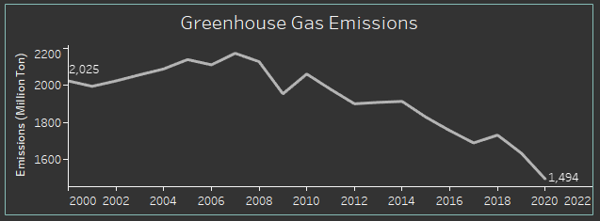
Greenhouse
Gas Emission
Down from 2025 in 2000 to 1494 in 2020
26% decrease
Notes:
Million ton

Slide 11
Reduce Emission
Increase renewable energy generation
Solar: new tech, cheaper
Wind: offshore
New Projects: wave, current, and tidal energy
Nuclear electricity is a clean and efficient source of electricity, but it is also controversial due to concerns about safety and the disposal of radioactive waste. (When normalizing deaths per terawatt hour generated it is said to be among the safest)
Energy efficiency, reducing energy consumption through technological advancements
Tax incentives

Slide 12
Conclusion
Due to increased demands, electricity has been generated from a variety of sources, from fossil fuels of natural gas, coal, and oil, to nuclear, to renewable energy (solar, wind, and hydroelectric).
Fossil fuel sources are responsible for approximately 40% of all carbon dioxide pollution.
While fossil fuels still account for a substantial 60% of electricity generation there is a growing trend toward renewable energy sources.
The shift towards cleaner energy has achieved a 26% reduction in greenhouse gas emissions, this trend is expected to continue, as we transition towards more sustainable energy systems.
.

Slide 13

www.linkedin.com/in/ospinadiana https://public.tableau.com/app/profile/diana.ospina/viz/USElectricity_16947255709290/Electricity?publish=yes
Diana Ospina

